Slide 1
Scope and Visibility

Slide 2
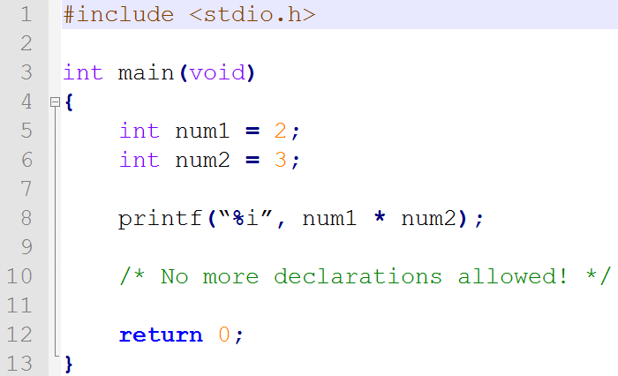
Declarations At The Top
The top of what?
So far, only at the top of main.

Slide 3
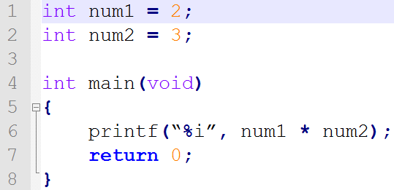
Declarations Other Places
At the top of the source file:

Slide 4
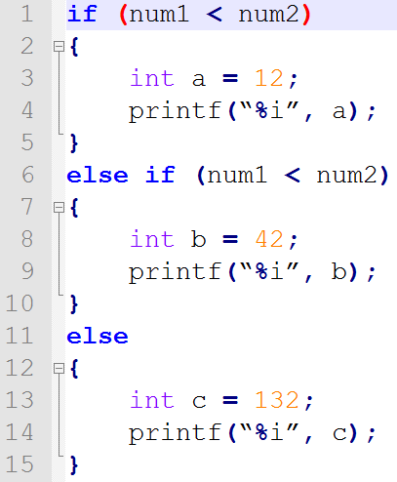
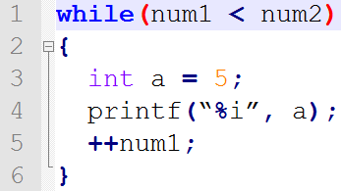
Declarations Other Places
At the top of an if, else if or else:
At the top of a loop:

Slide 5
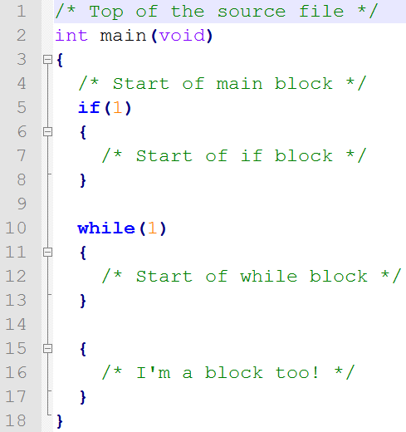
Declarations Everywhere?
Not quite everywhere, at the top of a block
(or at the top of the program)
Block refers to code between curly braces: { }

Slide 6
Scope
Where a variable can be used:
Inside the block it was declared
Inside any blocks inside of the block it was declared
Otherwise, not OK
The variable no longer exists!

Slide 7
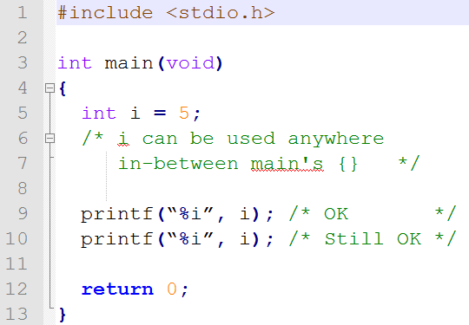
Single Block Scope

Slide 8
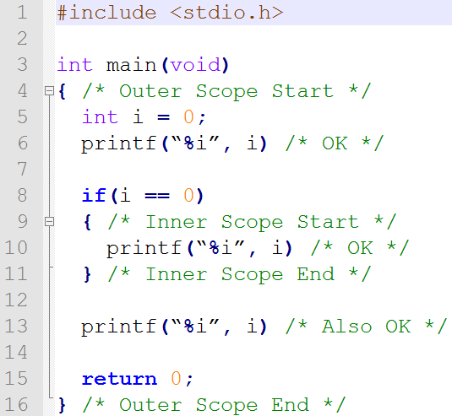
Multi-Block Scope

Slide 9
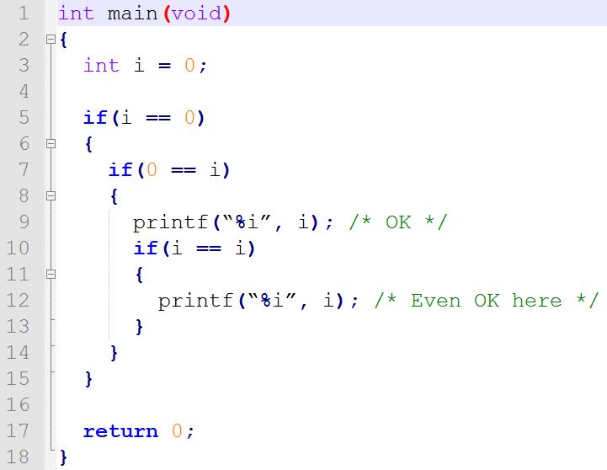
Multi Multi-Block Scope?

Slide 10
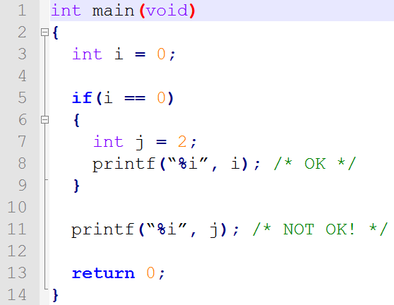
What Not To Do

Slide 11
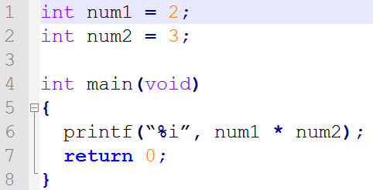
Global Scope
Declarations at the top of the file are in Global Scope
Can be used anywhere in the file
Highest level of scope

Slide 12
Unique Identifiers... Sometimes
Remember:
An identifier is a name of a variable or function
They must be unique!
Unique within a block
Can reuse a variable identifier as long as it's in a different block

Slide 13
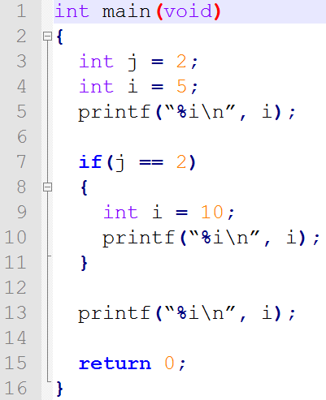
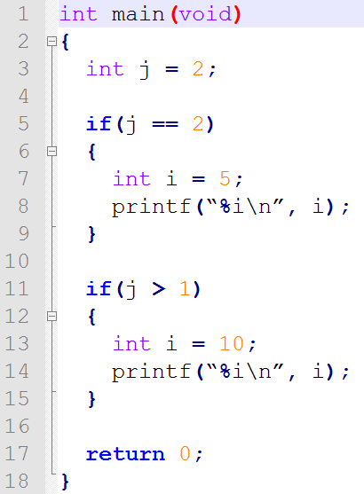
Reusing Identifiers

Slide 14
Visibility
Whether or not a variable can be seen by the code
Variables in an outer block are hidden by variables with the same identifier in an inner block
What does the code to the right print?

